Slide 1

HATE SPEECH DETECTION
Capstone Project on
Presented By - Shivam Mishra
Supervised by - Mr. Rithik raj Vaishya

Slide 2
INTRODUCTION
In a world increasingly connected by digital platforms, the rise of hate speech poses a significant challenge to the safety and inclusivity of online spaces.
But What is Hate Speech? – Hate Speech is public speech that expresses hate or encourages violence towards a person or group based on their inherent characteristics
My Hate Speech Detection Project is driven by the imperative to create a digital environment that is respectful, tolerant, and free from discriminatory language.
The project focuses on a comprehensive approach to hate speech detection, encompassing various forms of offensive language, from explicit to subtle expressions of discrimination
Understanding the impact of hate speech on individuals and communities is pivotal for fostering positive online interactions.

Slide 3

Objectives
The primary objective is to develop a robust hate speech detection model capable of accurately classifying offensive language and discriminatory content in digital communication.
Secondary objectives include addressing biases, ensuring model transparency, and providing a tool that contributes to a safer online experience for users.
Explore different machine learning algorithms and techniques for hate speech detection. This could involve comparing traditional classifiers like Decision tree, Logistic Regression, Random Forest and Support Vector Machines to deep learning models like Recurrent Neural Networks.
Analyse the impact of data pre-processing techniques on model performance. This could involve experimenting with different methods for cleaning and feature engineering text data.

Slide 4
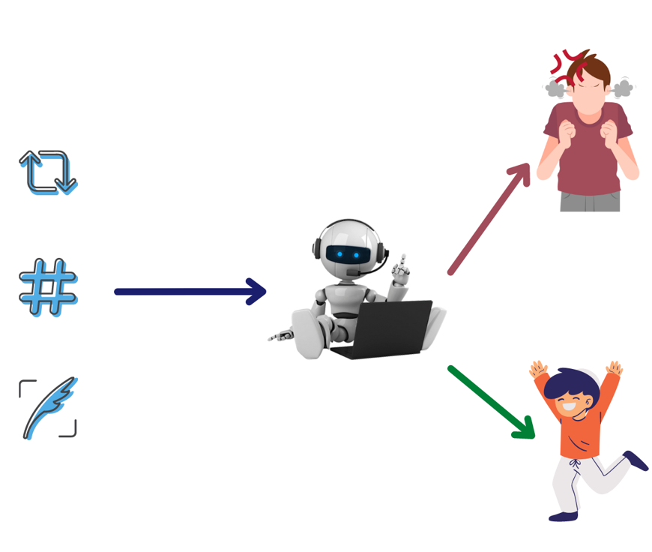
Dataset
The Dataset includes various information about
Hate speech,
Offensive Language,
Tweet
Labels.
Dataset Size: 24783 Rows x 8 Columns
Source : Kaggle

Slide 5
Methodology
Data Collection
Data Preprocessing
EDA And Visualization
Result
Classification models
Scaling Data

Slide 6
Machine Learning Models
ML models are build to check the accuracy, precision, recall and F1 score.
The models are build on the training and testing datasets.
In this project there are 6 classification models build –
Decision Tree - It is a flow chart-like structure in which each internal node represents a feature, each branch represents decision rule and each leaf note represents the outcome .They are one of the methods for organizing the data in a simple form.
KNN - It is a supervised machine learning algorithm. It is a non parametric, instance based and lazy learning algorithm.
SVM - It works by finding the hyperplane by dividing the dataset. It finds the optimal hyperplane.

Slide 7
Machine Learning Models
Logistic Regression - It is supervised machine learning used for classification in order to predict the probability that an element belongs to class or not (0 or 1).
Random Forest - Random Forest consists of n numbers of decision trees. It belongs to a learning called ensemble learning which works by combining classifiers to solve a problem and improve the performance of the model.
Naive Bayes - The Naive Bayes algorithm is a probabilistic supervised machine learning method used for classification tasks

Slide 8
Result
Models | Accuracy before tuning (%) | Accuracy after tuning (%) (GridSearchCV and RandomisedSearchCV)
Decision Tree | 88 | -
KNN | 85 | 85,85
SVM | 89 | 89,90
Logistic Regression | 89 | 90,90
Random Forest | 89 | 77
Naïve Bayes | 84 | 84,87
Models | F1 Score before tuning (%) | F1 Score after tuning (%) (GridSearchCV and RandomisedSearchCV)
Decision Tree | 34, 82, 93 | -
KNN | 38, 67, 91 | 37, 72, 91 and -
SVM | 12, 85, 94 | 12, 85, 94 and 30, 85, 94
Logistic Regression | 79, 98, 98 | 28, 85, 94 and 28, 85, 94
Random Forest | 36, 82, 94 | and 0, 1, 87
Naïve Bayes | 1, 56, 91 | 31, 75, 91 and 17, 76, 92

Slide 9
Conclusion
After performing all the classification algorithm, I got the different accuracy and F1 Score.
According to result the SVM and Logistic both are best fit model for this dataset.
But if we can see the F1 Score of Logistic Regression its good as compare to SVM.
So, Logistic Regression is best fit for this dataset.

Slide 10
Thank You!!

